Slide 1

Unit-IV
Financial Planning:

Slide 2
CAPITAL
Capital means physical resources which yields income. Capital includes all the elements which are necessary for an organisation e.g. cash, land & buildings, machinery, tools , raw materials etc.
Capital can be defined as the wealth used in production i.e. wihich is a factor of production. The role of capital varies according to the nature of industry. In modern industry capital is extremely significant. More the capital more efficient is the production and lower is the cost of production.
Physical forms of capital are land and buildings machinery raw materials tools and business capital like Goodwill of the firm. Financial form of capital are shares, bonds etc.
Types of Capital
Capital can be classified into two types
1.Fixed capital
2.Working capital

Slide 3
Fixed capital
Fixed capital is associated with the amount of capital required by an enterprise for acquiring fixed assets e.g. Land and buildings plant and machinery and equipment etc., The capital invested in such asset cannot be easily converted into money. Since such assets are used over an over again for a number of years, hence are commonly termed as fixed capital.
Factors determining Fixed Capital;
  Nature of business
  Size of business or Scale of operations
  Technique of Production
  Technology Up-gradation
  Growth Prospects
  Diversity of production line
  Methods of production
  Methods of acquisition of fixed assets or Availability of Finance and Leasing Facility
  Level of Collaboration/Joint Ventures

Slide 4
Factors determining fixed capital
1. Nature of Business: The type of business Co. is involved in is the first factor which helps in deciding the requirement of fixed capital. A manufacturing company needs more fixed capital as compared to a trading company, as trading company does not need plant, machinery, etc.
2. Scale of Operation: The companies which are operating at large scale require more fixed capital as they need more machineries and other assets whereas small scale enterprises need less amount of fixed capital.
3. Technique of Production: Companies using capital-intensive techniques require more fixed capital whereas companies using labour-intensive techniques require less capital because capital-intensive techniques make use of plant and machinery and company needs more fixed capital to buy plants and machinery.
4. Technology Up-gradation: Industries in which technology up-gradation is fast need more amount of fixed capital as when new technology is invented old machines become obsolete and they need to buy new plants and machinery whereas companies where technological up-gradation is slow they require less fixed capital as they can manage with old machines.

Slide 5
Factors determining fixed capital
5. Growth Prospects: Companies which are expanding and have higher growth plan require more fixed capital as to expand they need to expand their production capacity and to expand production capacity companies need more plant and machinery so more fixed capital.
6. Diversification: Companies which have plans to diversify their activities by including more range of products require more fixed capital as to produce more products they require more plants and machineries which means more fixed capital.
7. Availability of Finance and Leasing Facility: If companies can arrange financial and leasing facilities easily then they require less fixed capital as they can acquire assets on easy installments instead of paying huge amount at one time. On the other hand if easy loan and leasing facilities are not available then more fixed capital is needed as companies will have to buy plant and machinery by paying huge amount together.
8. Level of Collaboration/Joint Ventures: If companies are preferring collaborations, joint venture then companies will need less fixed capital as they can share plant and machinery with their collaborators but if company prefers to operate as independent unit then there is more requirement of fixed capital.

Slide 6
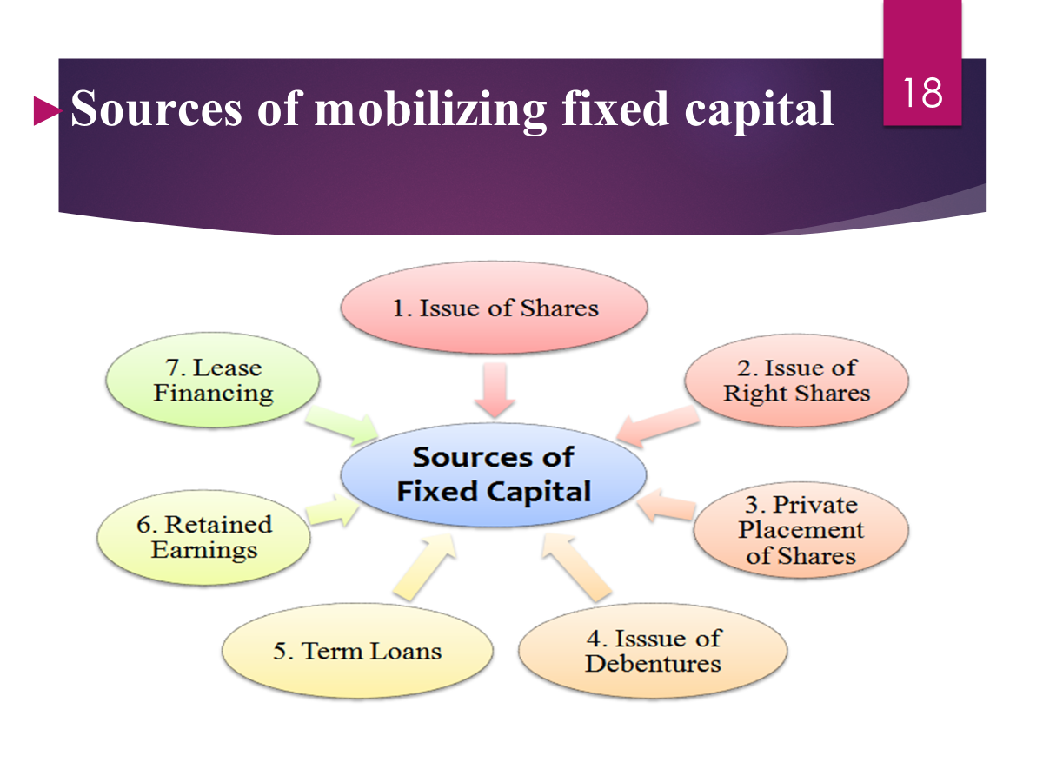

Slide 7
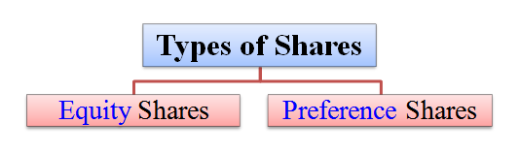
Source 1. Issue of shares
(i) Equity share:
  Equity share carries ownership rights of the company, and it doesn't carry a fixed rate of dividend.
  Equity shares are more popular than preference shares. The face value of an equity share is decided by the company. This share is also called ordinary share. This is because shareholders are the real owners of the company.
  The share capital is also called risky capital. This is so because there is no guarantee for getting a dividend. Similarly, if the company winds up or shut down, there is no guarantee for getting repayment of capital.
(ii) Preference share:
  A preference share carries ownership rights of the company, and it carries a fixed rate of dividend.
  A preference share has two main advantages over equity shares viz.;
  They get a fixed rate of dividend before the equity shares, and
  If the company winds up or shut down, they get repayment of capital before the equity shares.

Slide 8
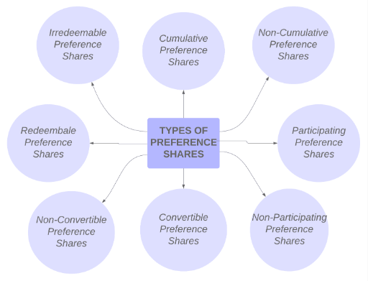

Slide 9
Source 2. Issue of Right shares
Rights issue of shares means the company issues shares to its existing shareholders. According to provisions of law, a company must first issue shares to its existing-shareholders.
If the existing shareholders do not want to buy the shares, then the company can sell its shares to the outsiders.
The existing shareholders are given first preference to buy the company's fresh issue of shares.
In an event of rights issue of shares, the share capital increases but the numbers of shareholders do not increase.
Generally, rights issue is very economical to collect fixed capital.

Slide 10
Source 3. Private placement of shares: Private placement of shares means the company sell its shares directly to a small-group of investors like bank, insurance companies, financial institutions, mutual funds, etc.
Here, the company does not sell the shares to the public.
It is a very simple and economical method as it does not involve issue of a prospectus, no need of brokers and underwriters, etc.
Fixed capital is also collected from private placement of shares.
Source 4. Issue of debentures: Debenture represents the borrowed capital of the company. Fixed capital is also collected from issue of debentures.
Debenture holders get interest for the capital contribution made by them to the company.
Debenture holders are the long-term lenders of the company.

Slide 11
Source 5. Term loans:
Term loans are secured or unsecured loans obtained by the company. The company has to pay interest on these term loans. The company gets term loans from banks and financial institutions like ICICI, HDFC, AXIS, and so on, by submitting its project analysis report.
The shareholders do not lose ownership control of the company by obtaining term loans. Fixed capital is also collected from term loans.
Source 6. Retained earnings
Retained earnings is a part of undistributed profits earned by the company. Since, the company does not distribute all of its profits to the shareholders. Company saves a part of its profits. This saved profit is called retained earnings, self-financing or ploughing back of profits.
It is very economical because no interest payment is to be made.Retained earnings is the cheapest source of fixed capital.
Source 7. Lease financing: In lease financing, there are two parties, viz;
Lessor, who is the owner of an asset, and Lessee, who is the user of an asset.
The lessor and lessee enter into an agreement. This agreement is called lease-agreement. The lessee need not spends money for purchasing the assets. Lessee hires (takes) the asset on a lease or rent so that he/she can use the available money for working capital requirements. Lease financing is very simple and economical.

Slide 12
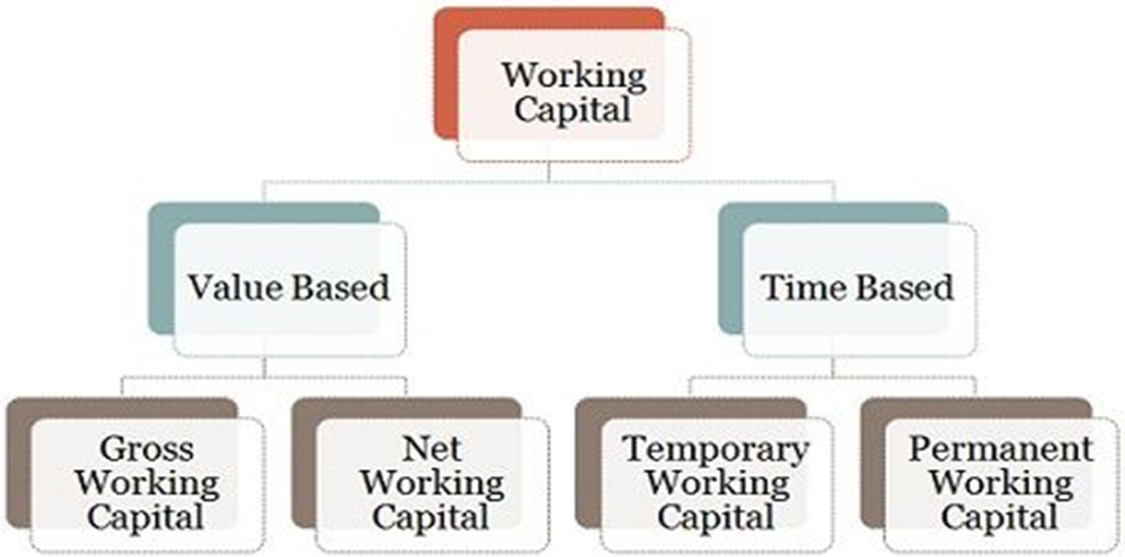
Working Capital
Working capital is that part of the capital which is required for the financing of current needs of the company. Working capital is usually invested in - Raw materials, accounts receivable, salaries rent, advertisement, plant and machinery maintenance etc.Since working capital is continuously circulating hence it is also known as “circulating capital”.
It is also termed “short term capital” because it's investment is usually for a shorter period as compared to fixed capital.
Types of Working Capital:

Slide 13
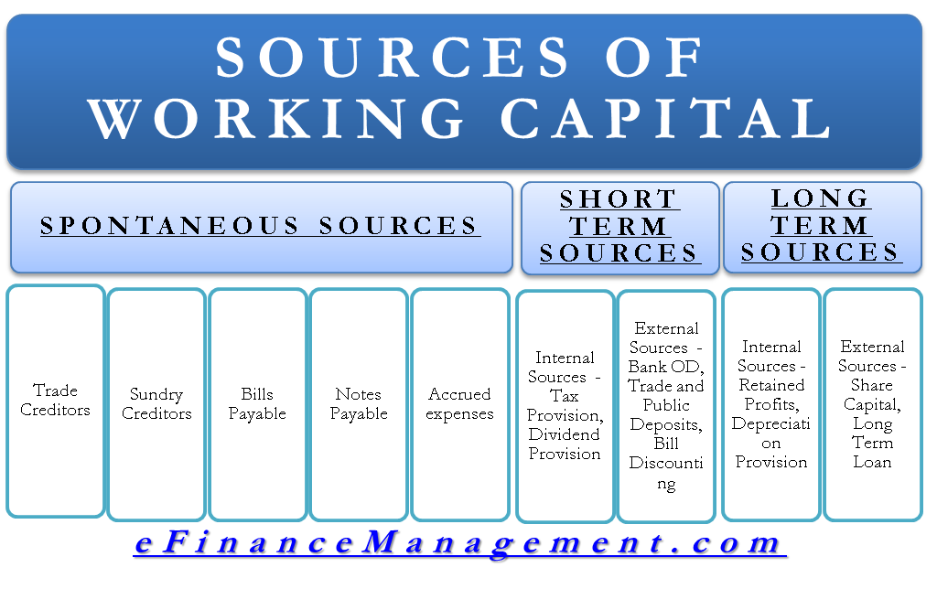

Slide 14
Financing of a New Venture / Stages of Financing
Financing and funding stages for a new venture typically progress in a series of rounds, each corresponding to different stages of the startup's growth and development.
Various sources of funding of New Venture:
1. Seed stage/ Bootstrapping
2. Start-up Stage
3. Series A
4. Series B, C, etc.
5. Initial Public Offering (IPO)
6. Debt Financing
7. Alternative Funding Sources

Slide 15
Financing of a New Venture
Seed stage /Bootstrapping: In the early stages, founders often rely on their own resources (savings, personal loans, credit cards) to fund the startup. This self-funding approach is known as bootstrapping. It allows founders to maintain control and ownership of the company without diluting equity.
2. Start-up Stage: The start-upstage is the initial phase of external funding for startups. Seed funding is typically provided by angel investors, incubators, friends and family, or early-stage venture capital firms. Funding at this stage is used to validate the business idea, build a prototype or MVP (Minimum Viable Product), and conduct market research.
3. Series A : The Series A round is the first significant round of institutional funding for startups that have demonstrated market traction and potential for growth. Series A funding is usually provided by venture capital firms and is used to scale the business, expand the team, and further develop the product or service.
4. Series B, C, etc.: Subsequent rounds of funding are referred to as Series B, Series C, and so on. These rounds typically involve larger investment amounts and are aimed at accelerating growth, expanding into new markets, or acquiring competitors. Funding at these stages may come from venture capital firms, private equity investors, or corporate investors.

Slide 16
Financing of a New Venture
5. Initial Public Offering (IPO): In some cases, successful startups may choose to go public through an initial public offering (IPO). An IPO allows the company to raise capital by selling shares to the public for the first time. Going public provides liquidity for existing investors and enables the company to access public capital markets for future growth and expansion.
6. Debt Financing: In addition to equity financing, startups may also utilize debt financing as a source of capital. Debt financing involves borrowing money from banks, financial institutions, or alternative lenders, typically in the form of loans or lines of credit. Debt financing can be used to fund specific projects, purchase equipment, or manage cash flow.
7. Alternative Funding Sources: In recent years, alternative funding sources such as crowdfunding platforms, revenue-based financing, and strategic partnerships have emerged as viable options for startups seeking capital. These alternative funding sources offer flexible terms and may be more accessible to certain types of businesses or industries.
Each financing and funding stage serves a specific purpose in the growth trajectory of a new venture, from validating the initial idea to scaling and expanding into new markets. It's important for founders to carefully consider their funding needs and objectives at each stage and to seek out the most appropriate sources of capital to support their growth plans. Additionally, founders should be prepared to negotiate terms with investors and to balance the trade-offs between equity dilution, control, and access to capital.

Slide 17
Financial projections and valuation
Financial projections and valuation are critical aspects when establishing a new firm. Here's a basic outline of steps to undertake:
1. Market Research 2. Revenue Projections
3. Cost Projections 4. Cash Flow Projections
5. Profit & Loss Statement 6. Balance Sheet
7. Valuation Methods 8. Discounted Cash Flow (DCF)
9. Comparable Company Analysis (CCA) 10. Asset-Based Approach
11. Sensitivity Analysis 12. Investor Considerations

Slide 18
Financial projections and valuation
1. Market Research: Conduct thorough market research to understand your target market, competition, and industry trends. This will help you make realistic assumptions for your financial projections.
2. Revenue Projections: Estimate your future revenue based on your market research, pricing strategy, sales channels, and projected market share. Consider factors such as seasonality, customer acquisition costs, and potential growth.
3. Cost Projections: Determine your operating expenses including salaries, rent, utilities, marketing, and other overhead costs. Be detailed and realistic in estimating these expenses.
4. Cash Flow Projections: Forecast your cash flow by integrating your revenue and expense projections. This will help you understand when you might face cash shortages or surpluses.
5. Profit & Loss Statement: Prepare a projected profit and loss statement (income statement) which summarizes your revenue, expenses, and net income over a specific period (usually monthly or annually).
6. Balance Sheet: Develop a projected balance sheet which outlines your assets, liabilities, and equity at a specific point in time. This will give you insights into your firm's financial position.
7. Valuation Methods: There are several methods to value a new firm, including the discounted cash flow (DCF) method, comparable company analysis (CCA), and the asset-based approach. Choose the method that best suits your business model and industry.

Slide 19
Financial projections and valuation
8. Discounted Cash Flow (DCF): Estimate the present value of your firm's future cash flows. This method considers the time value of money and the risk associated with your business.
9. Comparable Company Analysis (CCA): Compare your firm to similar publicly traded or privately held companies. Analyse their financial metrics and valuations to estimate your firm's value.
10. Asset-Based Approach: Calculate the value of your firm's assets minus liabilities. This method is suitable for asset-heavy businesses such as manufacturing or real estate.
11. Sensitivity Analysis: Perform sensitivity analysis to understand how changes in key assumptions (such as revenue growth rate or discount rate) impact your valuation.
12. Investor Considerations: If seeking investment, understand the expectations of potential investors regarding returns and risks. Your financial projections and valuation should align with these expectations.
Remember, financial projections and valuation are based on assumptions and estimates, so it's essential to regularly review and update them as your business evolves. Additionally, consulting with financial experts or advisors can provide valuable insights and ensure the accuracy of your projections and valuation.

Slide 20
financial management
Finance Function / Financial Management:Financial management involves strategically planning, organizing, directing, and controlling an organization’s financial resources to achieve its objectives efficiently and effectively. It encompasses activities such as budgeting, forecasting, cash flow management, investment decisions, risk management, and financial reporting.
The primary goal of financial management is to maximize shareholder wealth while ensuring the long-term sustainability and growth of the organization. This discipline is crucial for making informed financial decisions, optimizing resource allocation, mitigating risks, and maintaining financial stability.

Slide 21
OBJECTIVES OF financial management
Assessing Capital Needs: Financial managers need to evaluate factors such as the cost of current and fixed assets, cost of marketing, need for buffer capital, long-term operation, and human resources cost, etc. Successful businesses have clearly defined short-term and long-term financial requirement projections in place.
Determination of Capital Structure: A company’s capital structure is the framework that determines decisions such as debt-equity ratio in the short as well as long term.
Creation of Effective Financial Policies: There is a need to frame efficient financial policies that govern cash control, the lending and borrowing processes, and so on.
Resource Optimization: Great financial managers are able to navigate through different scenarios by making optimum use of the available financial resources. This would reduce the cash burn and increase the cash churn to generate maximum ROI.

Slide 22
Introduction to various keywords pertaining to financial management
Certainly! Financial management involves a wide array of concepts and terms that are essential for effectively managing finances within an organization or individual's life. Here's an introduction to various keywords pertaining to financial management:
1. Budgeting 9. Asset Allocation
2. Cash Flow 10.Financial Planning
3. Financial Statements 11. Cost of Capital
4. Risk Management 12. Financial Ratios
5. Investment 13. Hedging
6. Capital Budgeting 14. Working Capital Management
7. Financial Analysis 15. Dividend Policy
8. Leverage 16. Mergers and Acquisitions (M&A)

Slide 23
Introduction to various keywords pertaining to financial management
1. Budgeting: The process of creating a plan to manage income and expenses over a specified period, typically monthly or annually.
2. Cash Flow: The movement of money into and out of a business or individual's accounts, indicating liquidity and financial health.
3. Financial Statements: Reports that provide a snapshot of an entity's financial position and performance, including the balance sheet, income statement, and cash flow statement.
4. Risk Management: The process of identifying, assessing, and mitigating potential financial risks that could impact an organization's objectives.
5. Investment: Allocating funds into assets or securities with the expectation of generating returns over time, balancing risk and return.
6. Capital Budgeting: Evaluating and selecting long-term investment projects or expenditures that involve significant capital outlay.
7. Financial Analysis: Assessing the financial performance and position of an entity through quantitative and qualitative techniques
8. Leverage: The use of borrowed funds to finance investments or operations, amplifying potential returns but also increasing risk.
.

Slide 24
Introduction to various keywords pertaining to financial management
9. Asset Allocation: Distributing investment funds among different asset classes (e.g., stocks, bonds, real estate) to achieve a desired risk-return profile.
10.Financial Planning: Developing strategies to achieve financial goals through effective management of resources, income, expenses, and investments.
11. Cost of Capital: The rate of return required by investors or lenders to compensate for the risk associated with investing in a particular business or project.
12. Financial Ratios: Quantitative indicators used to assess various aspects of a company's financial performance and health, such as profitability, liquidity, and efficiency.
13. Hedging: Using financial instruments or strategies to offset the risk of adverse price movements in assets or liabilities.
14. Working Capital Management: Managing the company's short-term assets and liabilities to ensure operational efficiency and liquidity.
15. Dividend Policy: The strategy employed by companies to determine the portion of earnings distributed to shareholders as dividends versus retained for reinvestment.

Slide 25
Introduction to various keywords pertaining to financial management
16. Mergers and Acquisitions (M&A): Transactions involving the consolidation of companies through various forms such as mergers, acquisitions or takeovers.
Mergers involve two or more equals, while takeovers involve one larger company that takes over a smaller company. Mergers are always agreed upon using mutual consent, while acquisitions may or may not be friendly.
Merged companies choose a new name, while acquired companies often use the parent company’s name. Merged companies issue new shares, while no new shares are issued in a takeover.
These are just a few of the many keywords and concepts in financial management. Each plays a crucial role in helping individuals and organizations make informed decisions about their finances and investments.

Slide 26
various keywords pertaining to Investment:
Certainly! Investment involves allocating resources with the expectation of generating returns in the future. Here are some keywords pertaining to investment:
1. Asset Allocation: Distributing investment funds among different asset classes (e.g., stocks, bonds, real estate) to achieve a desired risk-return profile.
2. Portfolio Diversification: Spreading investments across different assets or securities to reduce overall risk.
3. Risk Management: Identifying, assessing, and mitigating potential risks associated with investments to protect capital.
4. Return on Investment (ROI): The measure of profitability or performance of an investment, typically expressed as a percentage of the initial investment.
5. Stocks: Ownership shares in a corporation, representing a proportional claim on its assets and earnings.
6. Bonds: Debt securities issued by governments or corporations, typically paying periodic interest and returning the principal amount at maturity.
7. Mutual Funds: Pooled investment vehicles that invest in a diversified portfolio of securities managed by professional fund managers.
8. Exchange-Traded Funds (ETFs): Investment funds traded on stock exchanges, representing a basket of assets such as stocks, bonds, or commodities.

Slide 27
various keywords pertaining to Investment:
9. Risk Tolerance: The degree of uncertainty an investor can handle regarding fluctuations in investment returns
10. Capital Preservation: Investment strategies focused on protecting the initial capital from loss or depreciation
11. Long-Term Investing: Holding investments for an extended period to capitalize on potential growth and compounding returns.
12. Short-Term Investing: Buying and selling assets within a relatively short time frame to capitalize on short-term price movements or opportunities.
13. Dividends: Distributions of earnings by a corporation to its shareholders, typically in the form of cash payments or additional shares.
14. Capital Gains: Profits generated from the sale of an investment at a higher price than its purchase price.
15. Financial Markets: Platforms where buyers and sellers trade financial assets such as stocks, bonds, currencies, and commodities.
16. Liquidity: The ease with which an investment can be converted into cash without significantly impacting its market price.

Slide 28
various keywords pertaining to Investment:
17. Volatility: The degree of fluctuation in the price of an investment over a period of time, indicating its riskiness.
18. Fundamental Analysis: Evaluating the intrinsic value of an investment by analysing factors such as financial statements, economic indicators, and industry trends.
19. Technical Analysis: Analysing past price movements and trading volume of securities to forecast future price trends.
20. Investment Horizon: The time frame over which an investor expects to hold an investment before selling it or cashing out.
These keywords provide a foundation for understanding various aspects of investment and are essential for making informed investment decisions.

